Slide 1
Summer Scholars Student and Parent Orientation
Kim Quick
EOF Assistant Director/Advisor
Humanities and Social Sciences
Notes:
Welcome Parents, Guardians, and Friends to the TCNJ EOF Family
We are here to assist you in supporting your students to reach their goals of obtaining higher education! Most importance, at some point your student will turn to you for advice and guidance and we want you to be ready. Today, we will familiarize you with EOF, college terminology, TCNJ resources, and how to parent a Lion.
Before we get started, I would like for each one of you to raise your right hand, reach over your left shoulder, and pat your self on the back. Being here today is a celebration.
At the end of this presentation, we ask that you take a few moments to complete the survey. There are also 2 Special Note Cards. Please write your student a special note. Our staff will distribute them next weekend.
1

Slide 2
EOF AT TCNJ
Kim L. Quick, MSW, LCSW, Ed.S.
EOF Assistant Director/Advisor
School of Humanities and Social Sciences
(HSS)
Email - quickk@tcnj.edu
Phone - 609-771-3369
Roscoe West Hall, Rm 126
Notes:
Financial Aid and HESAA document requests in a timely manner.
Make sure that your student opens all mail from The College of New Jersey and the Higher Education Student Assistance Authority in a timely manner. Some of the documents may need your signature.
Provide your student with income verification, i.e. tax records, social security annual income statement, disability annual income statement, and/or social service annual income statement in timely manner.
Complete your taxes in April and FAFSA before JUNE 1 every year. Your students TAG eligibility, EOF, and Promise Award may be affected.
Failure to provide this information or providing it late can have a negative effect on your student’s financial aid eligibility.
2

Slide 3
What will my student experience this summer?
7:00AM- 7:50 AM BREAKFAST
8:00AM- 10:00AM First Class
10:10AM-12:10PM Second Class
12:10 PM-1:10PM LUNCH
1:10PM-3:10PM Third Class
3:20PM-5:20PM Fourth Class
5:30PM-6:30PM DINNER
7:00PM-9:00PM TUTORING

Slide 4
TCNJ Summer Scholars Course Offerings
IDS 100 - Race, Class, & Gender (1 Unit)
IDS 097 – Foundations of Success (Pass/Fail)
IDS 170 – Principles for STEM Innovation (1 Unit)
IDS 102 – Library Literacy (non-credit)
Mat 095 – Algebra (1/2 Unit)
Mat 120 – Pre- Calculus (1 Unit)
Mat 127 – Calculus (1 Unit)
Stat 115 – Statistics (1 Unit)
Writing Studio (non-credit)
Math Studio (non-credit)
Notes:
Classes meet M-F for 2 hours each course
Courses are accelerated and require student commitment to focusing in class, completing all assignments, asking for help, and studying.
Discuss course offerings by major
Increased level of stress
Added Mindfulness and copy skills

Slide 5
FOUNDATIONS OF STUDENT SUCCESS
This course is designed to guide incoming first year scholars through the transition from high school to college.
Begin to develop college-level study and tests-taking skills
Learning the resources available to scholars at TCNJ
Weekly Themes – Transition, Coping Skills, Mapping your academic Future, Career Readiness

Slide 6
ON TRACK INITIATIVE
E
O
F
Freshman Year
Sophomore Year
Junior Year
Senior Year

Slide 7
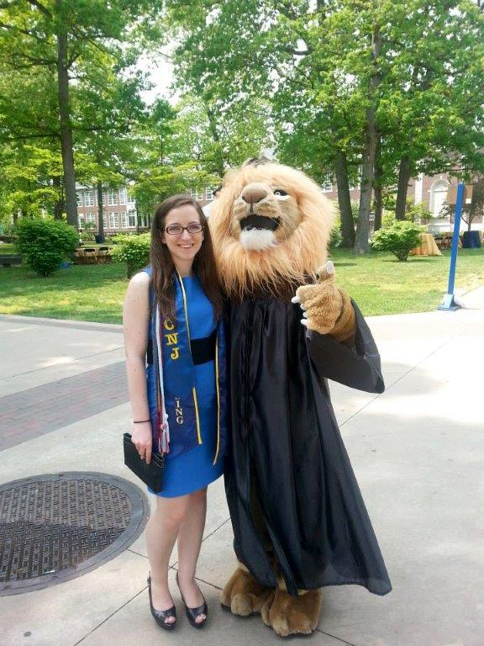
Support Services
Advising
Academic Support Programs
Disability Services
Tutoring
Math lab
Writing lab
CSS – Center for Student Success
Career Center
Health Services
Counseling and Psychological Services

Slide 8
Tutoring “A blessing in disguise”
Not a punishment
Daily Session Reports and Weekly Evaluation
Expectations
Purpose to provide additional support to increase confidence, test scores, and basic skills for a solid foundation
Opportunity to ask questions and clarify areas of difficulty

Slide 10
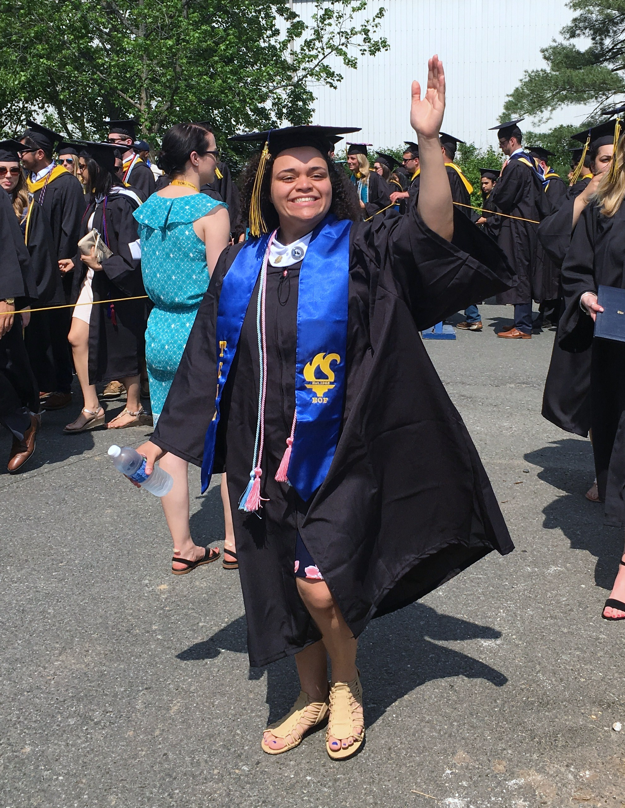
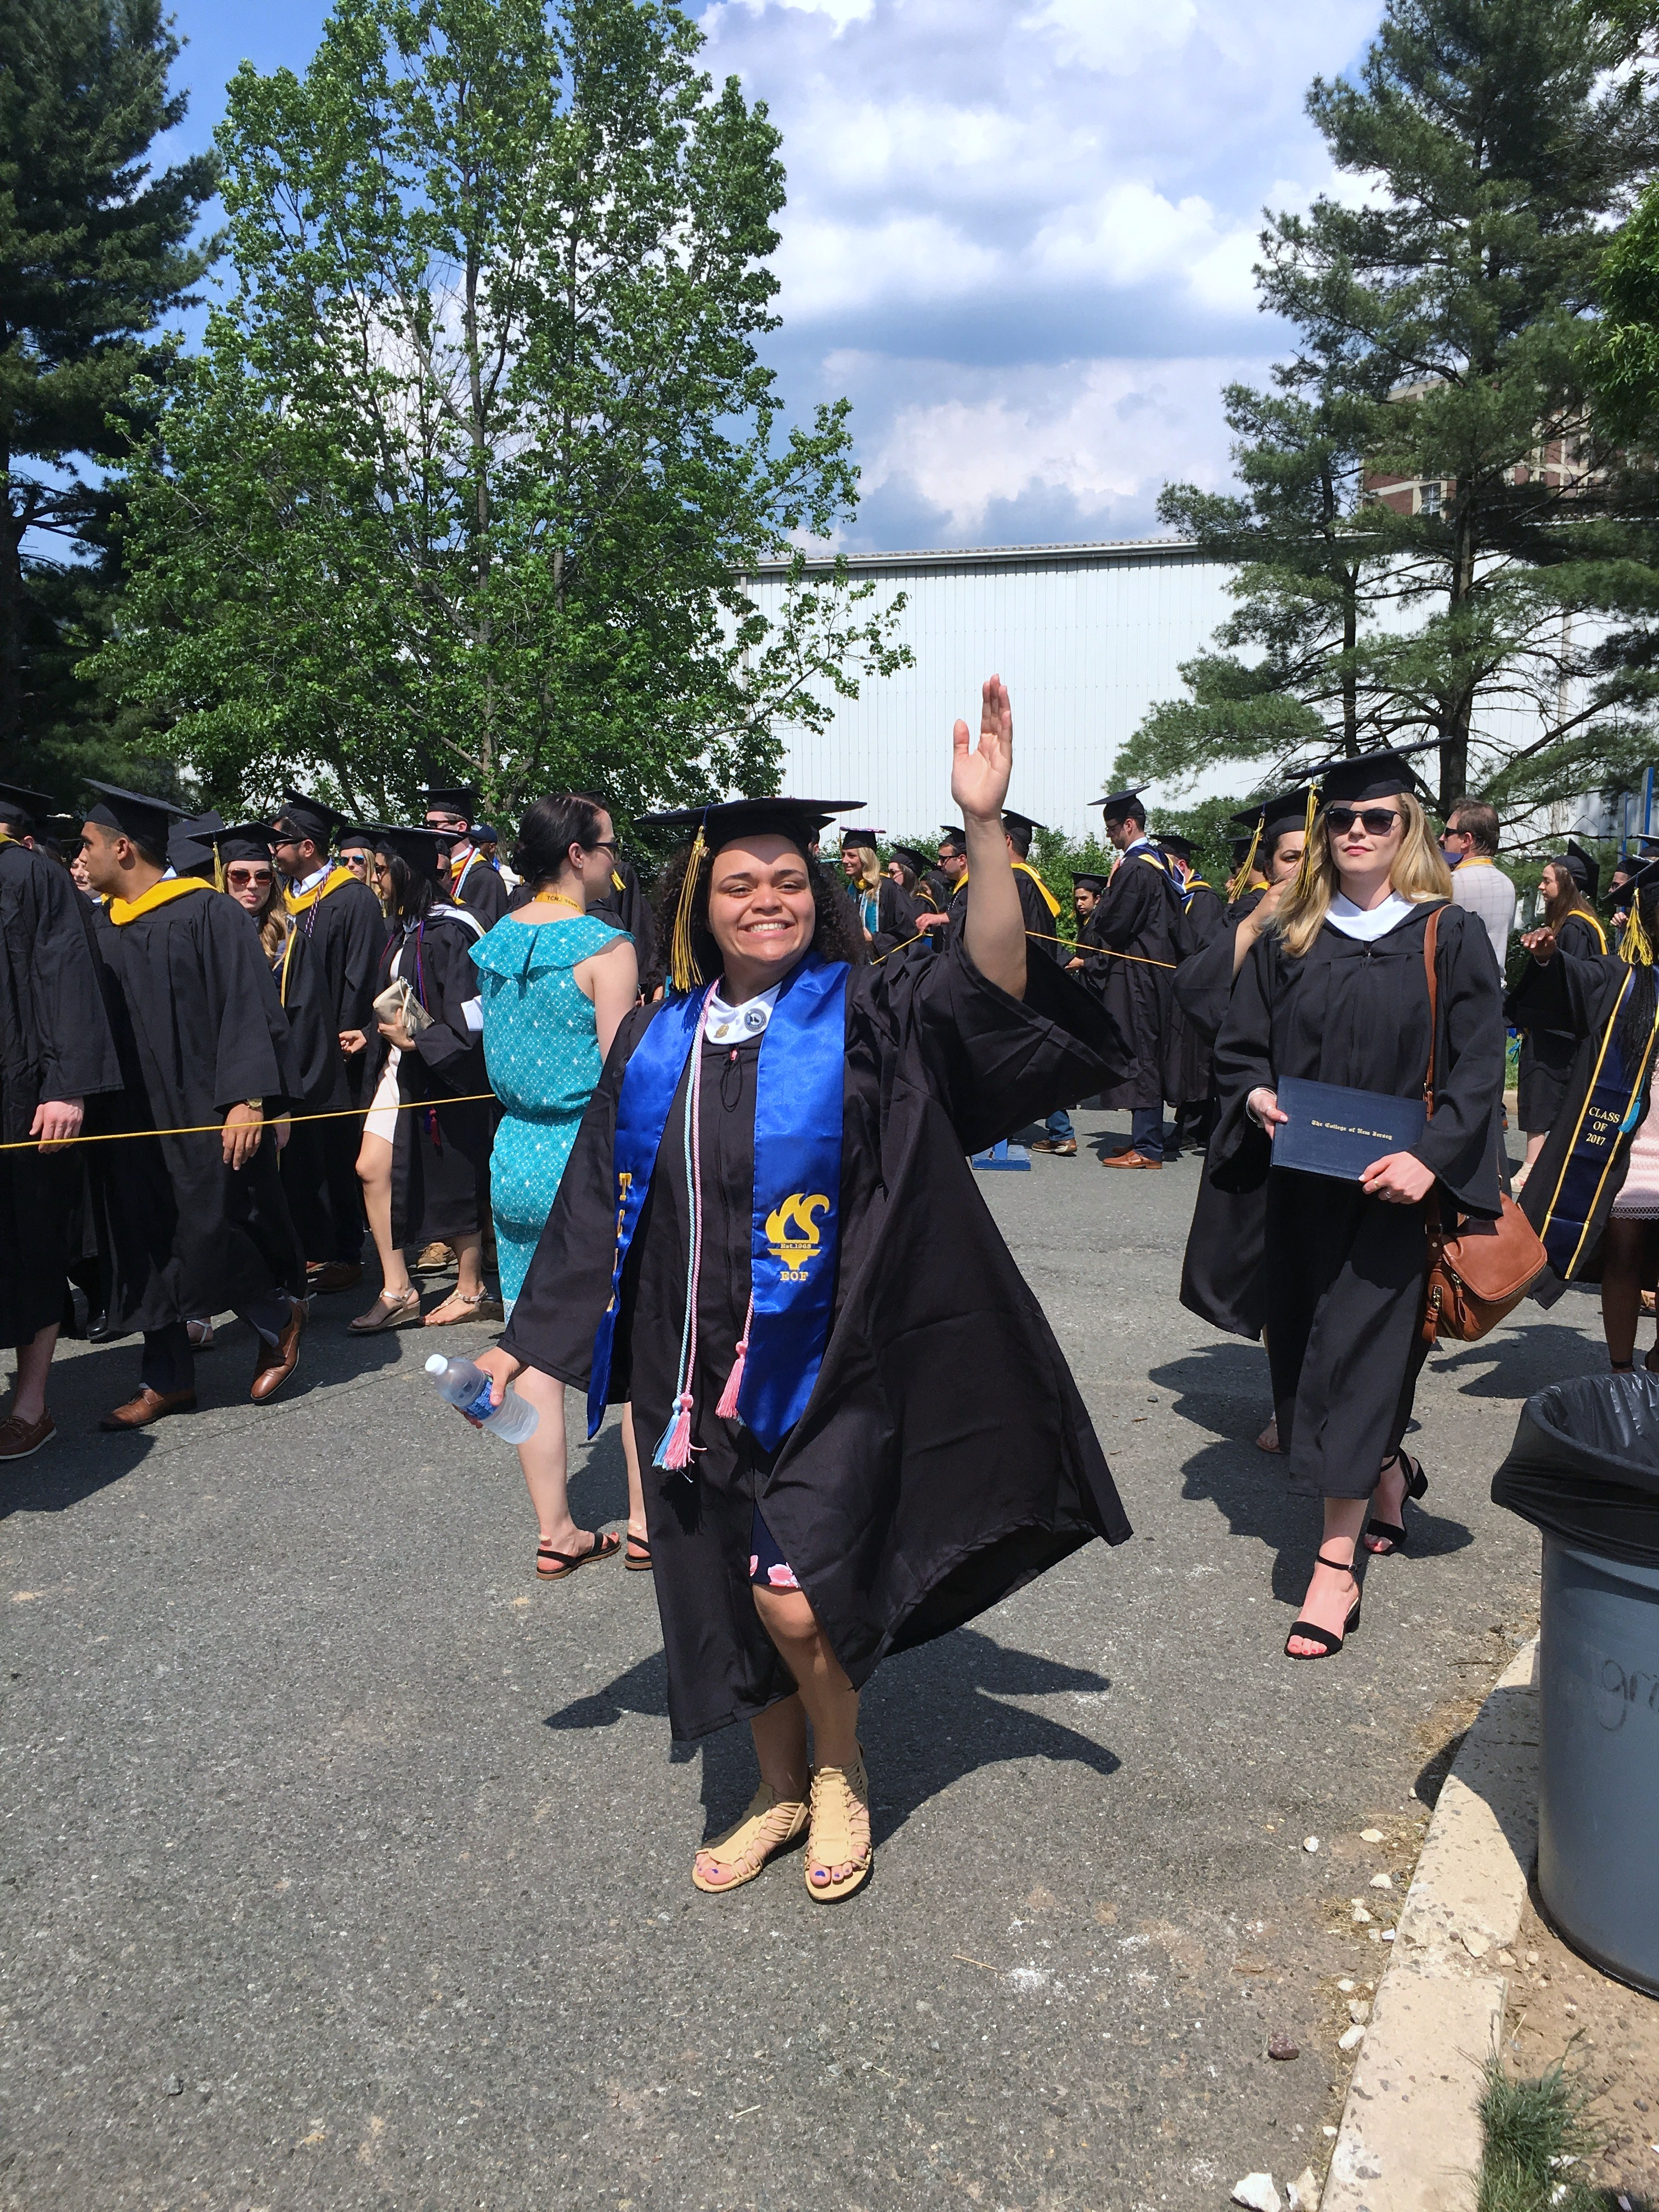

Slide 11
Mentor Connection
All EOF/Cooperman Scholars will be assigned a Peer Mentor for the first semester……
To help with the transition process
To be a supportive resource
To be that person to let you know it’s going to be ok

Slide 12
Parent Partnership
Parents/Guardians
What can you do to help your scholar be successful at TCNJ?
Notes:
12

Slide 13
Parent Partnership - continued
Prepare for homesickness
Be supportive, not smothering. (Don’t call everyday)
Stay Positive!
Encourage your student to use campus resources
Understand your child will have a new role - Their College Success is the New Priority
Expect Change
Call the EOF Office, if you have questions
Notes:
13

Slide 14
Student Partnership
What can YOU do to help yourself?
Notes:
14

Slide 15
Student Partnership (Continued)
Prepare for homesickness
Be ready to miss your mommy and daddy and your little siblings. Good news is they will be there when you return.
Be supportive, not smothering. (Don’t call everyday)
Get used to not speaking with your parent everyday. It will help you in the long run.
Stay Positive - Be Patient with the Process
Use the campus resources that we provide you
Expect Change and be comfortable with being uncomfortable.
Trust that this journey is for YOU!
Talk to your EOF Advisor/Mentor if you have any questions
Notes:
15

Slide 16
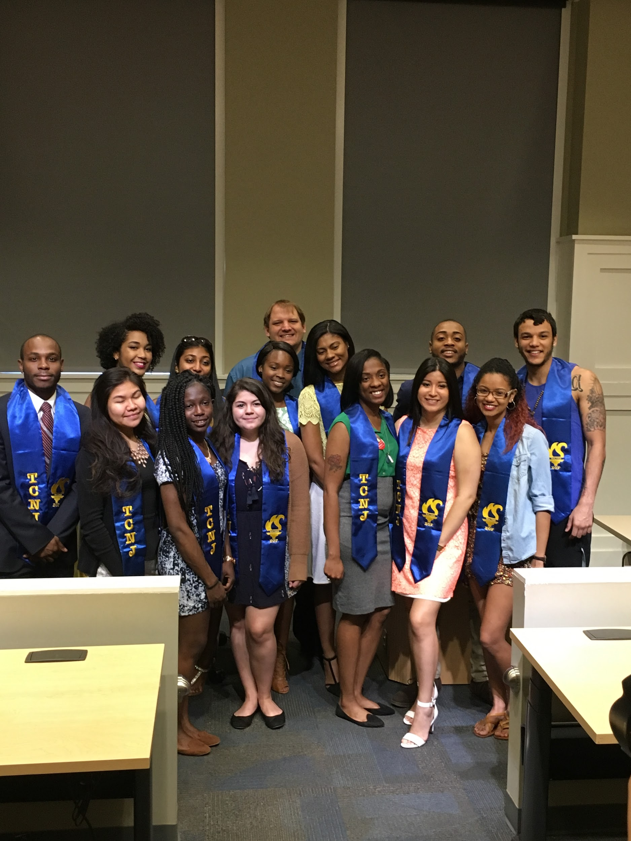

Slide 17
School of Humanities and Social Sciences
Dean - Dr. Jane Wong
wongj@tcnj.edu
Associate Dean – Lisa Grimm
grimm@tcnj.edu
Admin – Anne Marie Maratea
maratea@tcnj.edu
Department Chairs - For each Department
Faculty Advisors - Each student will receive a
faculty advisor in addition to an EOF Program Advisor
Freshman For A Day!

Slide 18
School of Humanities and Social Sciences
Location - Social Sciences Building, Room 302
609-771-3434
https://hss.tcnj.edu
HSS Quick Facts:
Largest of all the schools at TCNJ
Over 2,000 students enrolled campus wide
14 Different Majors
All programs offer rigorous training in transferable skills:Critical thinking, creative problem-solving, and excellent communication skills in both speech and writing.
Freshman For A Day!

Slide 19
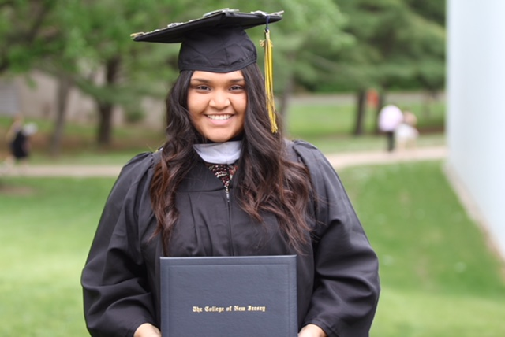
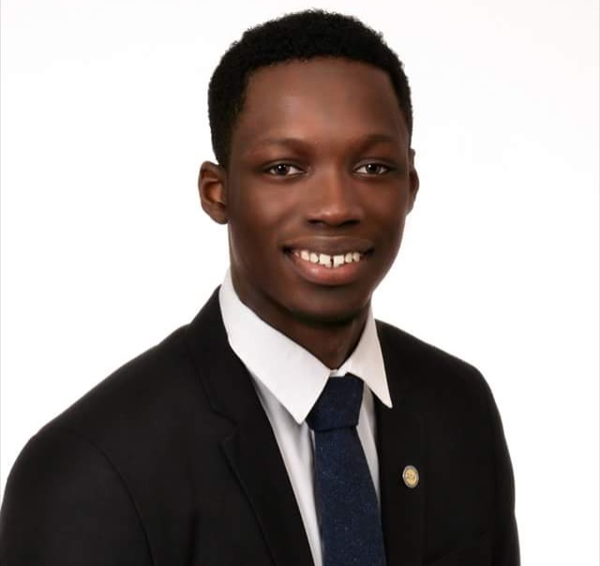
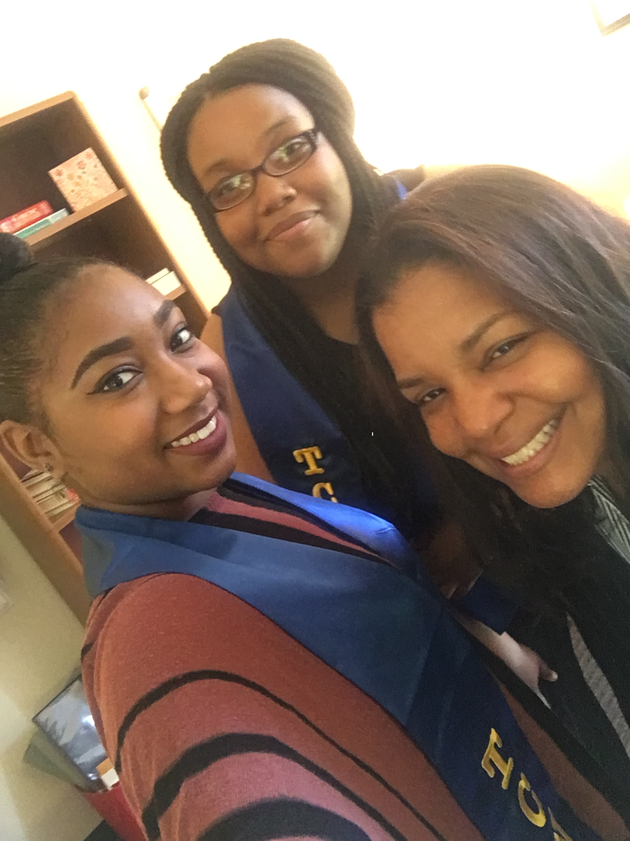

Slide 20
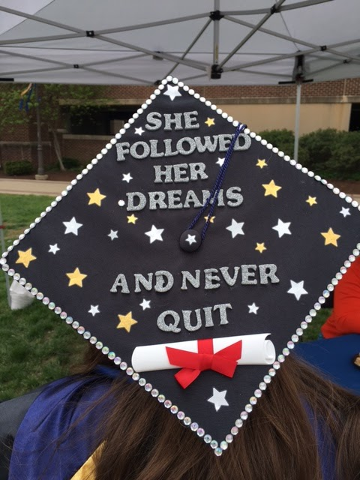

Slide 21
Save the Date!
Closing Ceremony
August 8, 2018
10:00 AM
Move Out
12:00 PM

Slide 22
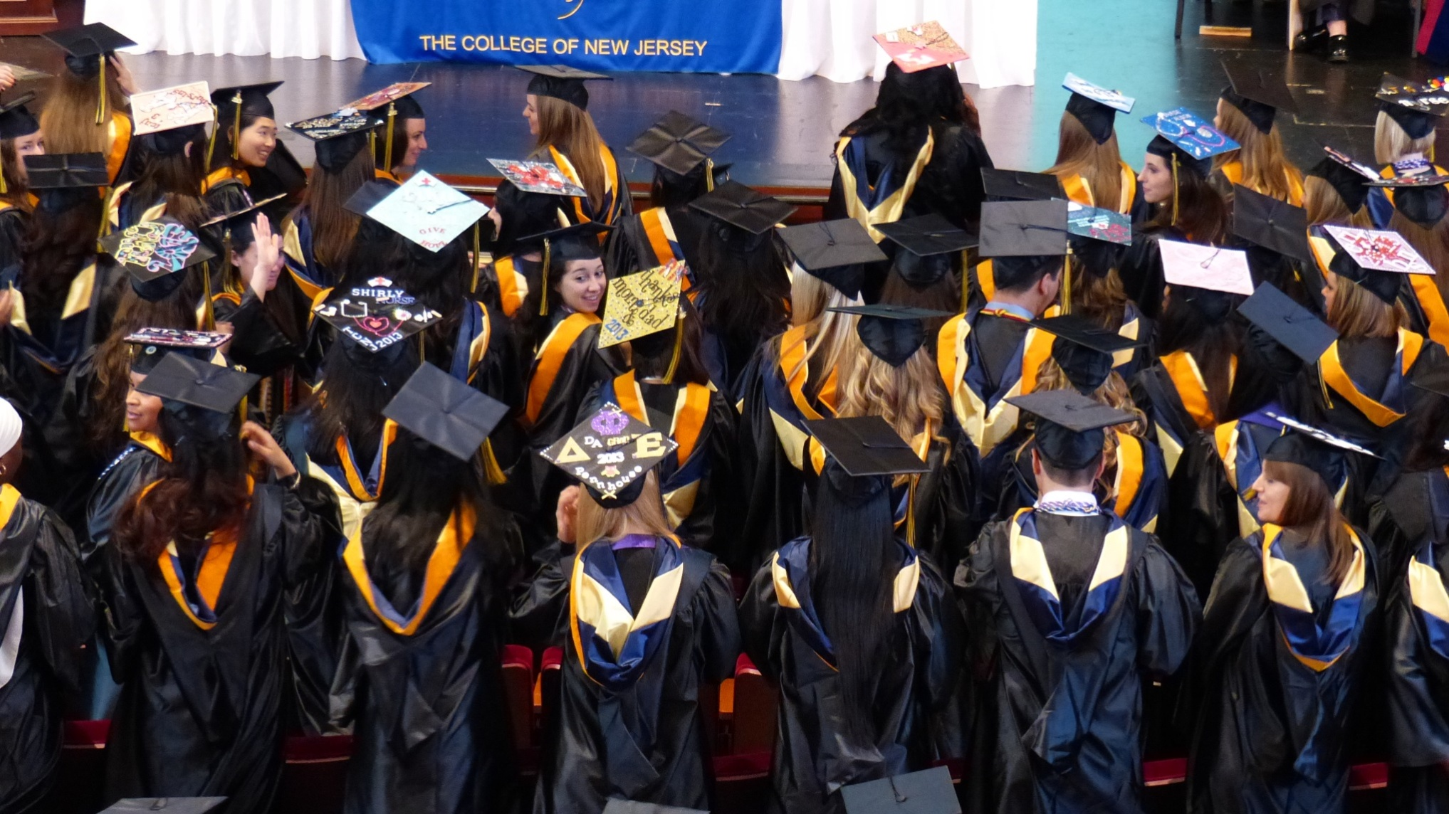
WELCOME TO THE FAMILY!!!
Class of 2021
Class of 2022

Slide 23
QUESTIONS?

