Slide 1
“Essentials to Financing College” educational opportunity fund
Junior and Senior year
Created By
Dionne L. Hallback
Associate Director
Office of Student Financial Assistance
Revised 3/11/2020

Slide 2

FASFA
2020-2021 FAFSA (2018 income) – FILE NOW!!
  HESAA requires the FAFSA is processed by 4/15/2020 to be considered for NJ TAG and EOF! Your FAFSA must be dated by 4/15/2020.
Federal Student Aid (FSA) ID - fsaid.ed.gov
Taxes files should use the IRS Data Retrieval Tool – if possible to avoid being selected for verficiation.

Slide 3
NJ HESAA
Renewal Students
2020-2021 deadline DATES
IMPORTANT FOR RECEIVING YOUR NJ TUITION AID GRANT AND EOF GRANT
FAFSA Filing Deadline *TIP: File the FAFSA with estimated information if needed so the FAFSA is processed by 4/15/17. You can log-in to the FAFSA to update information after 4/15/17. | April 15, 2020
Completed State Record in NJFAMS (State tasks, verification, corrections, reevaluations, etc.) | November 1, 2020
Spring 2021 (only students) (Complete State Records in NJFAMS) | March 1, 2021

Slide 4

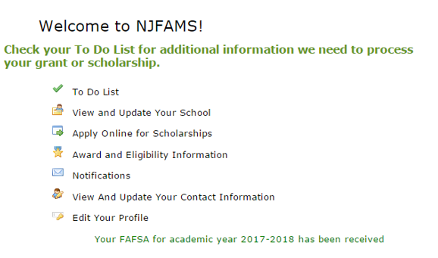
Check your NJ Grant Status Online!
Check File and Award Status 24/7

Slide 5

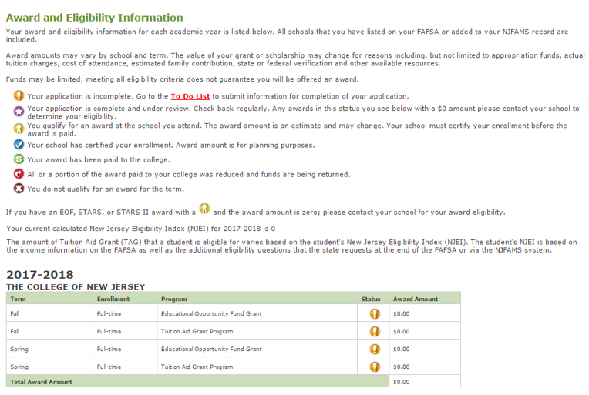
Indicators
Award Status

Slide 6
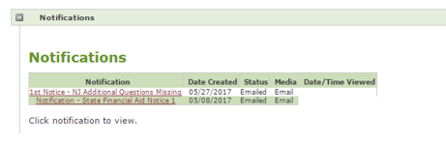
NJ HESAA will send emails to the students regarding outstanding documents and award notice. Monitor the email that is listed on your FAFSA!

Slide 7
Financial Aid Timeline
FAFSA
2020-2021 FAFSA must be filed by April 15th to be eligible for NJ TAG
Verification and Awarding
March 2020– Verification process begins: check your PAWS To Do List and TCNJ Email. Submit your documents now while you are still on campus!
June - Awarding begins for continuing students on a weekly basis
Billing and
De-Registration
July – Fall bill email notifications are sent (Office of Student Accounts) and first payment is due for the Installment Payment Plan.
August – Fall bill is due
August – De-Registration
Use 2018 income to file the 2017-2018 FAFSA
March – August – Monitor both your PAWS and NJFAMS account!

Slide 8
Federal and state Grants
Pell Grant: Federal grant awarded on the basis of need and college costs.
  0 to $6345
Tuition Aid Grant (TAG): State grant awarded on the basis of need, cost of attendance and available funding.
  $2,718 – 9,488
  (The 2020-2021 amounts have not been announced.)
NJ ED Opportunity Fund (EOF): Standard EOF grant awarded to all students in the program.
  $1150 (commuter) and $1400 (on campus)
Supplemental Opportunity Grant (SEOG):
Awarded to the neediest students as defined by the FAFSA (zero EFC).
SEOG funding is limited and is not available to every student.
  $1500 (2020-2021 have not been determined)

Slide 9
EOF Incentive Scholarship
Junior Year
Level | Amount | Units | CGPA
Level 1 | $500.00 | 12 | 2.250
Level 2 | $1,000.00 | 13.75 | 2.500
Level 3 | $3,000.00 | 15 | 2.750
Level 4 | $5,000.00 | 16 | 3.000
Senior Year
Level | Amount | Units | CGPA
Level 1 | $500.00 | 18 | 2.250
Level 2 | $1,000.00 | 20 | 2.500
Level 3 | $3,000.00 | 22 | 2.750
Level 4 | $5,000.00 | 24 | 3.000
Questions regarding the EOF Incentive Scholarship can be directed to
Joan Pageau at pageauj@tcnj.edu or 609-771-3142

Slide 10
Private Scholarships
  JLV College Counseling
    https://jlvcollegecounseling.com/scholarships/all-scholarships-2/
  FinAid.org
    www.finaid.org
  The College Board
    www.collegeboard.com
  FastWeb.com
    www.fastweb.com
  GoCollege.com - The Collegiate Websource
    www.gocollege.com

Slide 11



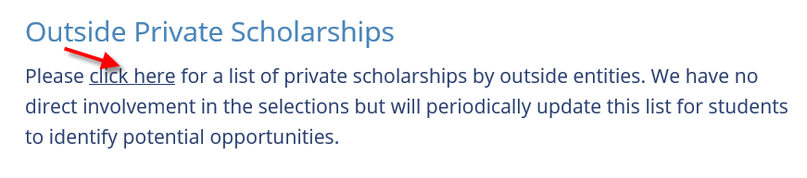
TCNJ Financial aid
Private Scholarships POSTINGS!
#1
#2
#3
#4

Slide 12
Loan Programs
Loan | Application Process | Interest | Fees | Amount Borrowed
Stafford | FAFSA | Fixed 4.529% | 1.059% | Depends on academic year
NJ Class (credit-based) Students with a co-signer Or Parent/adult | HESAA.org | Fixed Option 1: 3.99% *Monthly payment principal Option 2: 4.49% *Monthly payment principal and interest – OR- interest only Option 3: 6.50% *Deferment *Rates for 2020-2021 announced 7/1/2019 | 3% | Up to cost of attendance
Parent PLUS* | PLUS Application | Fixed 7.079% *Any changes will be announced 7/1/2020 *Application is on the Financial Aid website . | 4.248% | Up to cost of attendance **Parents who are denied; students are awarded additional Federal Direct Unsubsidized Loan: $4000.00 as a sophomore $5,000 junior & senior)
Bank Loans (student or parent) | Lender Application | See lender website | No | Up to cost of attendance

Slide 13
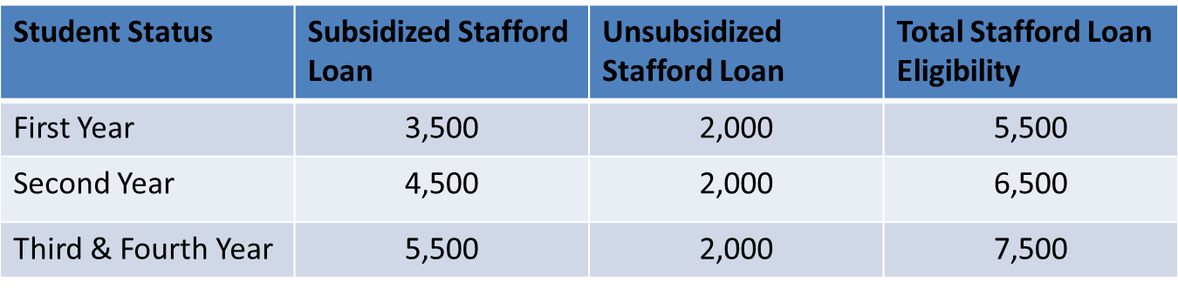
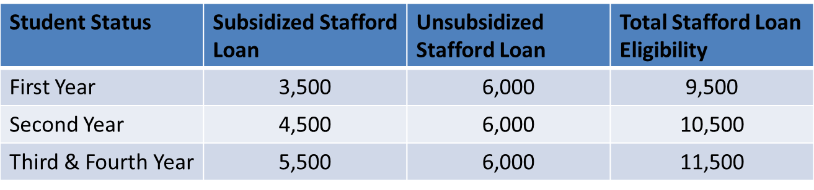
Direct Stafford Loans
Dependent Students
Independent Student
The award amount depends on your ‘academic level’ per earned units.

Slide 14
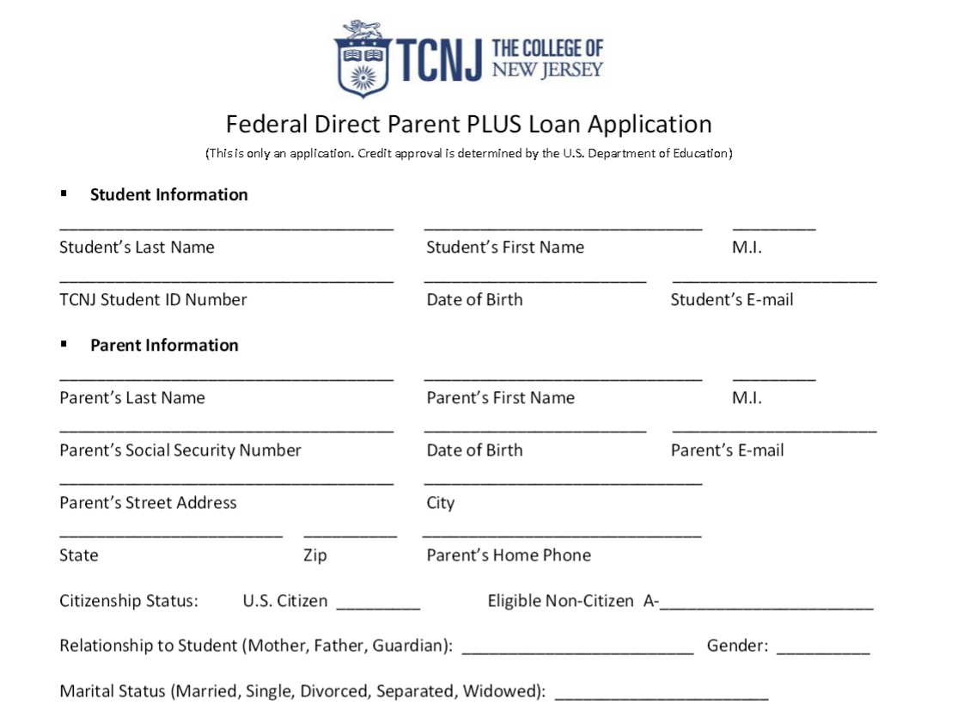
Additional Federal unsubsidized stafford loan (plus loan denial)
A parent completes the PLUS Loan Application and submits it to the FA Office.
Denied PLUS Loan
Awarded additional Federal Unsubsidized Stafford Loan:
Sophomores receive $4,000
Juniors and Seniors receive $5,000
*Award amount is dependent on
your academic level
FA Office automatically posts the additional Federal Unsubsidized Loan.
PLUS Loan Application can be downloaded from our website in late June for the next award year.

Slide 15

Alternative Loans
(TCNJ does not certify any alternative and/or private loan unless a FAFSA is on file.)
SallieMae
www.SallieMae.com/tcnj
Citizens
www.CitizensBank.com/trufitstudentloan
Discover
www.DiscoverStudentLoans.com
Wells Fargo
www.WellsFargo.com/student
See the Financial Aid website for Alternative Loan List &
Online Loan Comparison Tool

Slide 16

Books
Reminder your EOF Promise Book Stipend ends your Sophomore year!

Slide 17
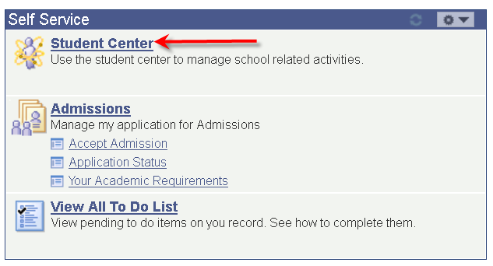
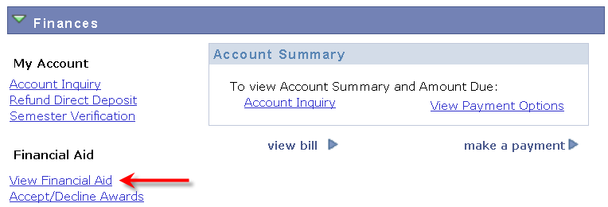
Estimating fall 2020 and spring 2021 Financial aid and gap (I.E. BALANCE)!
Schedule an appointment to meet with an Associate Director by emailing OSFA@tcnj.edu or call 609-771-2211.
You may also use the following steps to estimate your bill and potential balance due for the next aid year.
1. Log into PAWS and click on ‘Student Center’
2. Click ‘View Financial Aid”

Slide 18
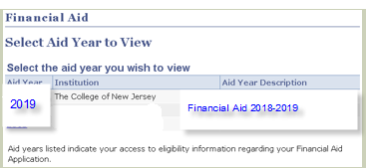
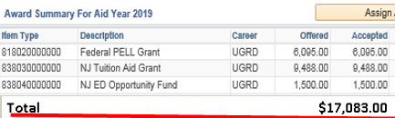

Estimating fall 2020 and spring 2021 aid and gap (I.E. BALANCE)! – CONT’D…
3. Click the current aid year (this example ‘2019’)
4. View your total amount of Financial Aid by ‘Aid Year’ or by “Terms”.
Calculate ONLY Pell, TAG, NJ EOF
Total Financial Aid year $17,083.00
Total per semester $8,541.50
($17,083/2)

Slide 19
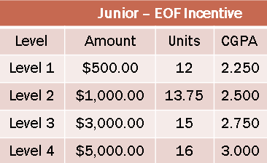
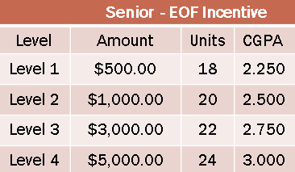
Estimating fall 2020 and spring 2021
Financial aid and gap (I.E. BALANCE) CONT’D…
5. Add additional Financial Aid you may be eligible for as a junior and/or senior:
Total Financial Aid $17,083
Stafford Loan (new) $ 6500
(Jr. $6500 & Sr. $7500)
*Note: Net amount will be
less due to the loan fee
EOF Incentive (new) $ 3,000
*Note: Refer to the EOF Incentive
charts below
Estimated Financial Aid Year $26,583.00
Per Semester $13,291.50

Slide 20
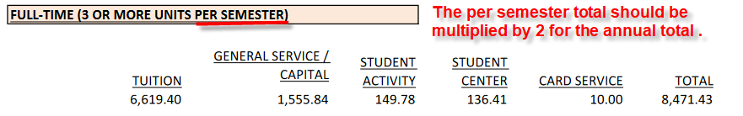
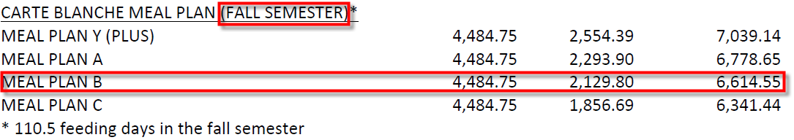
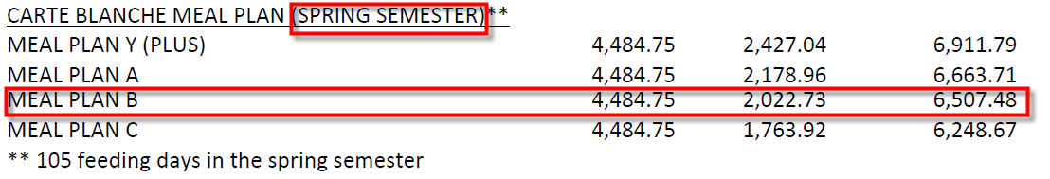
Estimating fall 2019 and spring 2020 aid and gap (I.E. BALANCE)! – CONT’D…
6. Use the current tuition and fee rates to calculate your bill for the next year. Anticipate a slight
Increase based on the tuition and fee archives. - https://studentaccounts.tcnj.edu/tuition-fees/.
This example 2019-2020 tuition and fees per semester. Multiply the total by 2 for the
annual total. Factor in a slight increase based on tuition and fee archives.
8,471.43 x 2 = $ = $16,942.86 year
$17,000/2 = $8,500 per semester (assumes an increase in tuition and fees)
7. View your housing and meal plan rates at the bottom of the tuition and fee chart
https://studentaccounts.tcnj.edu/tuition-fees/. Factor in a slight increase based on archives.
Fall $6,614.55 + Spring $ 6,507.48 = $13,122.03 = $13,200. year
2) $13,200/2= $6,600 per semester

Slide 21
Estimating fall 2020 and spring 2021 aid and gap (I.E. BALANCE)! – CONT’D…
8. Calculate the following to determine if you may owe a balance for the next aid year:
 | FALL 2020 | SPRING 2021 | TOTALS
Estimated 2020-2021 Financial Aid Per Semester (refer to #5) | 13,291.50 | 13,291.50 | 26,583.00
Tuition & Fees (refer to #6) | - 8,500.00 | - 8,500.00 | -17,000.00
Room and Board (refer to #7) | - 6,600.00 | - 6,600.00 | -13,200
Estimated Balance/Gap for next year | - $1,808.50 | - $ 1,808.50 | - $3,617.00
*Student owes a balance.
How will you pay for the ‘estimated balance? Discuss with parent/guardian and schedule an appointment with a Financial Aid Counselor to discuss your options?
Private Scholarships
Private/Credit-based loans or Parent Plus Loan Denial / Additional Unsubsidized Stafford Loan
Installment Payment Plan

Slide 22
BUDGETING: LIVING OFF CAMPUS
Living off campus requires planning! Below are steps to help determine if living off campus is affordable for you!
1. What are the ‘estimated” expenses?
* Rent, food, electric, cable, cell, TCNJ parking permit, books, miscellaneous, etc.)
2. What is your ‘estimated Financial Aid for the Fall and Spring for next year?
  * Review the total amount of your current Financial Aid in PAWS. Make an appointment
  with a Financial Aid Counselor to discuss Stafford Loan options which are based on your
  ‘academic level’ not your year at TCNJ.
3. Subtract the Estimated Financial Aid from the current Tuition and Fees for
Fall and Spring.
* If you have an excess amount this is an estimated refund for
you to pay your expenses.
Refund checks are not issued until September (Fall semester) and February (Spring semester.
* You must budget your Fall refund to last you until your Spring refund. Also be prepared to submit your rental deposit before your receive your refund check.

Slide 23
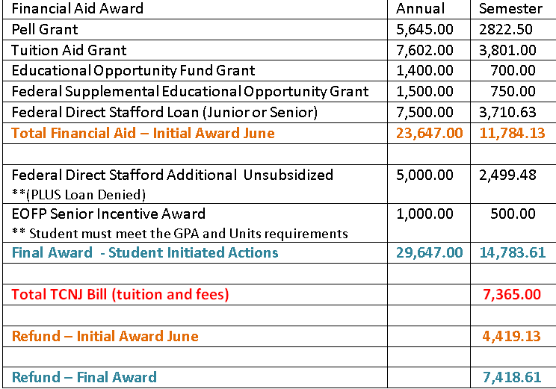
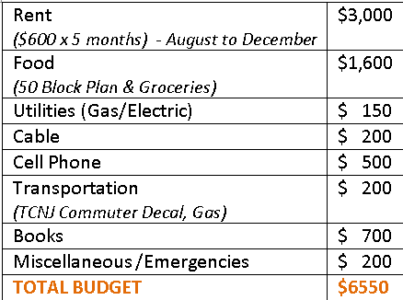
Financial aid and budgeting living off campus EXAMPLE
What are your expenses for living off campus?
Example: Fall semester (5 months)
Reminder: Refund checks are not issued until the following:
Fall semester: mid-September
Spring semester: mid-February

Slide 24
Summer Financial Aid
Financial Aid for Summer Programs Students
Complete the 2020 TCNJ Summer Session Financial Aid Application in PAWS. Instructions are on our website: http://financialaid.pages.tcnj.edu/sources-of-financial-aid/financial-assistance-for-summer-programs-students/
Your financial aid file must be complete by June (date posted to website in May).
You must have made Satisfactory Academic Progress at the end of the Spring semester to be considered for Summer assistance.
Must be enrolled half-time
  Undergraduate students - enrollment hours of at least 1.5 units
Types of Financial Aid
Federal Pell Grants – based on the EFC and is only available if you are enrolled full- time (3 or more units), three-quarter time (2-2.5 units), half time (1.5 units).
Federal Stafford Loans – based on remaining eligibility from the previous academic year.
Federal Direct Plus Loan Denial – if not used during the academic year
Private Loans – students will need a co-signer unless parent or another third party applies for the loan.

Slide 25

Study abroad
*EOF Students must attend an ‘Exchange Program’, TCNJ Semester program or Faculty Led Program in order to use the NJ Tuition Aid Grant funds towards the Study Abroad Program.
The following information will be reviewed during the counseling session:
Cost of the Study Abroad Program – bring your Study Abroad Cost Sheet.
Financial Aid Options to cover the Study Abroad Program
Budgeting
Timeline (i.e. Financial Aid disbursement, refund checks, etc.)
*Research the Benjamin Gilman International Scholarship which is awarded to Federal Pell Grant recipients. http://www.iie.org/Programs/Gilman-Scholarship-Program#.WKywG2clupo

Slide 26
To do List
FEBRUARY – MAY
  File the 2020-2021 FAFSA by April 15th if you have not filed.
  To receive NJ Tuition Aid Grant your FAFSA MUST BE FILED BY APRIL 15th!
  Monitor your TCNJ Email and PAWS To Do List for outstanding Financial Aid documents needed to complete your file. Submit all documents TIMELY!!!
  Meet with a Financial Aid Counselor to develop a plan of action for next year.
    What are Stafford Loans? Do I need to take the full amount of Stafford Loans?
    Do I need to prepare for applying for a private loan? What is the process?
    How do I budget to live off campus?
    Other questions?
MAY-JUNE
  Monitor your NJ HESAA Account and mail. Submit documents TIMELY! If you do not understand how to complete a document call HESAA or contact our office for guidance. DO NOT WAIT UNTIL AUGUST TO SUBMIT DOCUMENTS AND ASK FOR HELP!
JUNE-AUGUST
  Monitor your TCNJ email for your Financial Aid Award Notification. Emails are sent on a weekly basis.
  Review your tuition bill in July and begin to implement your plan of action in June!
  Submit to NJ HESAA all required documents as requested. HESAA verification deadline is 11/1/20!
  FINANCIAL AID OFFICE AND HESAA OFFICES ARE OPEN ALL SUMMER
  EXCEPT FOR FRIDAYS AND HOLIDAYS!

Slide 27
FINANCIAL AID APPOINTMENTS
Schedule an appointment to meet with an Associate Director to review and/or discuss any of the following options:
Estimating your Financial Aid and Potential Balance for next year
Living off Campus and Financial Aid options
Summer Financial Aid
Winter Financial Aid
FAFSA processing issues
Special Circumstances
Other!!
Email OSFA@tcnj.edu
Call 609-771-2211
Green Hall 101
*If you visit the office and receive help at the receptionist desk but still want to meet with an Associate Director, let the staff know you will wait if they are meeting with a student or schedule an appointment. Counselor appointment days are:
  Dionne L. Hallback – Tuesday and Thursday
  Tom Foga – Monday and Wednesday
  *Fridays are walk-in appointments

Slide 28
QUESTIONS

Slide 29
Contact Information
The Office of Student Financial Assistance
Green Hall – Room 101
Dionne L. Hallback or Tom Foga 609-771-2211
osfa@tcnj.edu
www.tcnj.edu/~sfs/aid/

