Slide 1
Educational Opportunity Fund
Accepted Students Day
April 2, 2022
Notes:
Tieka
- Hello Everyone. Thank you for joining us today. My name is Dr. Tieka Harris, and I’m the director of the Educational Opportunity Fund Program at The College of New Jersey.

Slide 2
Student Success & Retention
The portfolio of programs housed within SS&R include:
Tutoring Center
Center for Student Success
Educational Opportunity Fund Program

Slide 3
TCNJ EOF Staff
Dr. Tieka Harris
Director of EOF
Mr. Todd McCrary
Associate Director of EOF
Mr. John Marshall
Assistant Director for the Schools of Health & Exercise Science,
Nursing, Science, & Engineering`
Ms. Kim Quick
Assistant Director for the School of Humanities & Social Science
Mr. Khayriy Tilghman
Assistant Director for the Schools of Arts & Communication,
Business, and Education
Ms. Asianna Hall
Program Assistant
Mrs. Sylvia Speed
Administrative Specialist
Notes:
Tieka
Good morning, and thank you for joining us today. If you are interested in becoming an EOF student at TCNJ, then this is the presentation for you. We’ll start by introducing the staff who are on the Zoom today.
My name is Dr. Tieka Harris, and I am the director of the Educational Opportunity Fund Program at The College of New Jersey. I’ve been at TCNJ since August of 2018, but working with the EOF program in different capacities for 8 years.
All
Introduce yourself in order listed

Slide 4
EOF The TCNJ Promise
Notes:
Tieka
We’re excited to share information with you today about the EOF Program, and what that means for you as a student at TCNJ.

Slide 5
AGENDA
What is EOF?
Value of the TCNJ Promise
College Transitions
On Track: 4-year academic support model
The EOF Family
Notes:
Tieka
If you’ll stick with me for the next several minutes or so, you should leave this presentation knowing…
What EOF is
its intended impact on highly motivated students across the state of New Jersey, such as yourself
How we prepare you to transition well into college and maintain your momentum toward success
and how we at TCNJ will work to fulfill our Promise to you as a TCNJ EOF student
And keep you on track toward the goal of graduating from college within 4 years!

Slide 6
WHAT IS EOF?
Notes:
Tieka
So with that, let’s start with What is EOF?
You probably already know that “EOF” stands for the Educational Opportunity Fund of New Jersey
You may also know that almost every college and university within the state of New Jersey has an EOF program, although each may operate slightly differently

Slide 7
EOF History
1967 - Newark Riots
1968 - EOF founded, enacted by law
proposed program of special assistance to young men and women from economically and educationally disadvantaged backgrounds
establishment of a broad range of programs to address the basic conditions the cited as contributing to the summer of 1967’s unrest
Notes:
Tieka
What you may not know, is that
EOF was borne out of the civil unrest that was occurring all across the United States in the 1960’s – even in some of our own hometowns like Trenton, Newark, and Camden
At the time, legislators were trying to determine the best way to lessen the burden for those who had limited financial and academic opportunities in those cities and surrounding areas.
Thomas Kean, who would later become governor of the State of New Jersey proposed a program to address these limitations, which would provide special assistance to young people who had economic and educational challenges, and thus EOF was established.

Slide 8
EOF set the pace for many initiatives which today are widely incorporated into college life:
EOF History
Pre-college summer bridge program | Peer tutoring
Systematic retention efforts | Peer counseling
Multicultural curricula | Academic support courses
Student leadership development | Outcomes-based program evaluation
Today, the EOF program serves low-income, first-generation students who have demonstrated commitment, motivation, and potential for success in every county of the state. 50th Anniversary of EOF 1968 – 2018
Notes:
Tieka
In 2018, EOF as a statewide program, turned 50 years old, and in those 5 decades, the program has set the standard for many similar programs within the state and across the country
EOF specifically serves low-income, first-generation students who are committed, motivated, and who show great potential for success
Those traits of commitment, motivation, and the desire and potential for success are embodied in YOU, and students like you are the reason why EOF continues to thrive and show great success

Slide 9
TCNJ EOF Mission
The purpose of the EOF Program at The College of New Jersey is to facilitate student transitions and address developmental concerns which lead to college readiness, positive adjustments, academic success, and persistence to graduation,
and to prepare students with the knowledge, skills, abilities, and values which are necessary to compete in both a regional and global multicultural workplace, graduate study, and other personal and civic endeavors.
Notes:
Tieka
EOF has been present at TCNJ for 50 years as well
Here, our mission is to facilitate student transitions by addressing students’ developmental concerns.
Our goal FOR and WITH our students is to ensure they are college ready. That they adjust positively to the academic, social, and personal aspects of college, gain academic success, and persist to graduation in 4 years.
We want our graduates to be prepared to be competitive in any and all of their post-graduation goals, be it full-time work, contributing to their communities, or pursuing graduate school.

Slide 10
TCNJ EOF Accolades
#1 EOF Program with highest graduation rate in NJ senior public colleges
over 70% 4-year graduation rate
TCNJ Enrollment Database
96% of full EOF cohort in good academic standing
TCNJ Enrollment Database
NJ Office of the Secretary of Higher Education/EOF
Notes:
Tieka
Specifically, the EOF program at TCNJ
Has the highest graduation rate of all NJ senior public colleges
Regarding our graduation rate, in the last 3 years, our students have sustained a 4-year graduation rate over 70… Let me contextualize that number for you a bit – nationally, the 4-year graduation rate is around 60%. Our EOF student at TCNJ are significantly outpacing that number.
We have approximately 350 students in the TCNJ EOF program, and 96% of them are in good academic standing at the college. In fact last semester, 41.7% of all the TCNJ EOF students made the Deans List in Fall 2020, and of those
29 have a 4.0 term GPA for the fall
Those are numbers we are proud of, and I hope they allow you to see yourself among those very positive statistics.

Slide 11
VALUE OF THE TCNJ PROMISE
Notes:
Tieka
By this point, all of you have heard about the TCNJ Promise Award. While this is an award that will ensure all of your costs of attendance for the first and second years of college at TCNJ are paid for, when we speak of Promise, it’s more than the funding. We are speaking of a declaration, or a commitment between us as professionals and you as students to ensure you have the best possible college experiences as a participant in the TCNJ EOF program.

Slide 12
TCNJ Promise & Incentive Awards
The EOF commitment is a 4-year pledge to help students succeed and graduate in four years. This support allows EOF students to focus entirely on academic success and minimizes student loan debt.
The Promise Award was designed to help first and second year students meet the full cost to attend TCNJ.
The Incentive Award allows for a scholarship for the third and fourth years, up to $5,000.
Notes:
Tieka
As you are all aware, TCNJ EOF students receive the Promise Award as they matriculate into the college
The Promise Award is for our first and second year students and covers the full cost of attendance at TCNJ. No other EOF program has this award.
Further, for third and fourth year students, we offer the Incentive Award which allows students in those years to earn up to $5,000 each year.
Our goal is to reduce the loan debt of our students as they are pursuing their education so that your sole focus will be on your academic and social acclimation to college.

Slide 13
TCNJ Believes in YOU!
For the fall of 2019…
Over 1,800 students applied for EOF
85 freshmen joined the EOF Family
Over $3 Million awarded in Institutional Funds for the EOF Promise/Incentive Awards
$510,019
awarded through the EOF state funded grant (AY19-20)
Notes:
Tieka
TCNJ believes YOU are worthy of our commitment to your education and your future
That’s why you’re here, watching this presentation today.
As you can see from the information shown here, many students are interested in becoming TCNJ Lions. Last year, over 1800 students applied to be a part of EOF at TCNJ, and we accepted 85 students into the program.
And when you look at the numbers shown here, I think we can all agree that a significant commitment from the College and the State of New Jersey is made to our students’ education.

Slide 14
What We Do
Pre-College | During College | Post-College
Summer program Exposure to college expectations Work with current professors Paired with EOF assistant director Build academic skills Learn the lay of the land | Start the academic year with a cohort of peers On-Track Advising AESNJ EOF Ambassadors EOF Mentoring Program EOF Statewide Graduate Achievement Awards | EOF Graduate Grants EOF Student Alumni Association (EOFSAA) TCNJ EOF Alumni Association “Your network is your net worth!”
Notes:
Todd
When you think of EOF – the 85 Initial students who will join us this summer, and who will connect with the rest of the cohort at the College, you should think of the program as an Extension of Family. We often repeat the refrain that “once EOF, always EOF,” as we are the proverbial family that you choose to engage with in your pre-college experience, during college, and once you graduate. Our family begins the moment you commit to joining our Pride, and strengthens each step of the way…
We’ll speak briefly about each stage…

Slide 15
What We Do
Pre-College | During College | Post-College
Summer Scholars Exposure to college expectations Work with current professors Paired with EOF assistant director Build academic skills Learn the lay of the land
Notes:
Todd
The EOF program requires students to participate in a pre-college summer bridge program. The goal of this program is to facilitate a successful transition into college.
Again, this is a mandatory program in which students earn college credit (or units), build academic skills, learn actively, and engage socially with their peers. Summer Scholars allows students to transition from high school to college, while learning the culture of college in general and TCNJ specifically.
Summer Scholars is free program where all of your courses and materials are paid for. We provide peer tutoring, and you get to know your EOF advisor and begin to build mentoring and professional relationships with your professors.
What’s great about EOF is that we understand that college and transitioning to college requires more than just academic work,
so we incorporate plenty of social activities to ensure you experience balance in your transition. Also, this helps you bond with your fellow students, which will be essential as you go into the fall semester.

Slide 16
What We Do
Pre-College | During College | Post-College
 | Start the academic year with a cohort of peers On-Track Advising AESNJ EOF Ambassadors EOF Mentoring Program EOF Statewide Graduate Achievement Awards
Notes:
Todd
As a further expression of our commitment to you, is ensuring that you maintain your commitment to yourself as a student and take advantage of the many opportunities for you to engage on campus, for example as an EOF ambassador, and with other EOF students across the state through our Association of EOF Students of NJ, whose main goal is to advocate for and promote EOF
A very important aspect of your college experience will be the relationship you develop with your EOF advisor, who will provide you with academic support. You and your advisor will work to keep you on track, from the time you enter in the summer through graduation in 4 years

Slide 17
Academic Support
Academic Success
Course selection, academic coaching, referrals to campus resources, etc.
Financial Success
Understanding FAFSA & HESAA guidelines, financial aid, etc.
Personal/Social Success
Introduction to campus clubs & organizations, managing relationships, emotional intelligence, etc.
Professional Success
Connecting students with professors and research opportunities, preparing for graduate school, etc.
Staying “On Track”
Advisement and coaching to ensure graduation in 4 years.
Notes:
Todd
Specifically, your EOF assistant director helps you with everything
I liken EOF to a wheel, and in the hub or center of that wheel are you and your EOF advisor
The spokes of the wheel are the many different college and outside resources that you will need on your collegiate journey
So, they work with you to select courses each semester, help you understand pertinent financial information, help you determine how to best utilize your talents in different campus organizations, and pushes you to grow through those experiences
Ultimately, our goal for you is a comprehensive college experience in which you get to learn, grow, connect, and influence change in the 4 years that you’re here at TCNJ

Slide 18
What We Do
Pre-College | During College | Post-College
 |  | EOF Graduate Grants EOF Student Alumni Association (EOFSAA) TCNJ EOF Alumni Association “Your network is your net worth!”
Notes:
Tieka
Once you graduate in 2025, we don’t end our relationship with you. Just like your family doesn’t stop communicating with you once you move out of the house. There are still many ways to engage, such as the EOF Student Alumni Association through which you can network with other EOF students
Someone once told me that “Your network is your net worth,” which exemplifies that fact that making connections throughout your EOF family is essential to your success

Slide 19
MAKING CONNECTIONS TCNJ EOF ALUMNI
Educators
Doctors and Nurses
Entrepreneurs
Real estate developers
State legislators
Photographers
Non-profit leaders
Engineers
Professors & College Presidents
Counselors and Therapists
Notes:
Todd
Our EOF alumni are everywhere and doing many different things
In fact, the immediate past NJ State Commissioner of Education, Dr. Lamont Reppollett, is a TCNJ EOF alumnus. He’s now the president of Kean University.

Slide 20
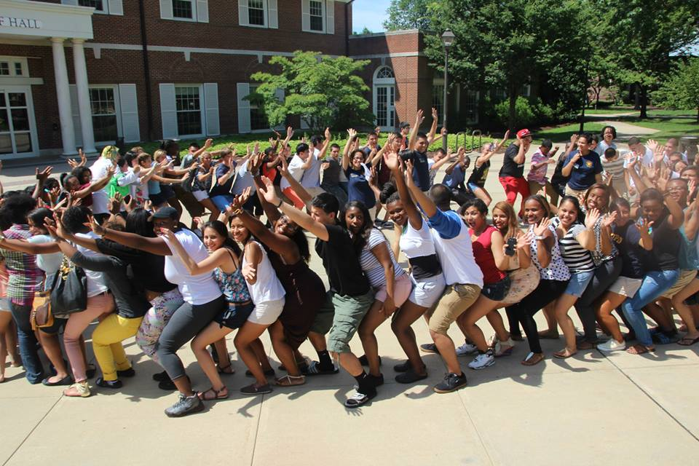
The EOF Family
Extension Of
Family
Notes:
Tieka
This brings us to the close of the presentation. Our hope is that you are now more aware of what it means to be a part of the EOF family at TCNJ.

Slide 21
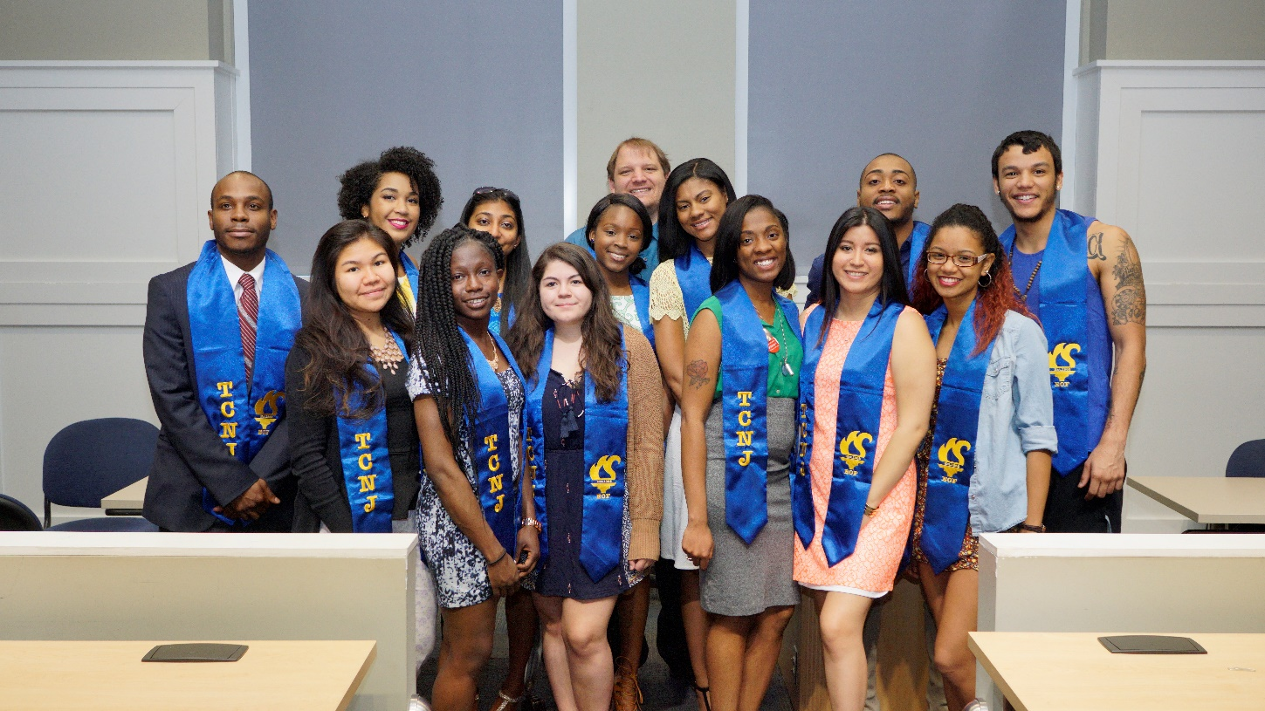
Be EOF Strong
JOIN THE PRIDE!
Notes:
Tieka
It has been our pleasure to share this information with you, and we look forward to you joining the pride.
Until then, be safe and be well.

Slide 22
Questions?
Mr. Roy Johnson
TCNJ EOF Admissions Recruiter
johnson.roy@tcnj.edu
Educational Opportunity Fund Program
eofp@tcnj.edu
Notes:
Tieka
Should you have any questions, be sure to contact Mr. Roy Johnson, your TCNJ EOF Recruiter. You may also contact the EOF office by email at eofp@tcnj.edu. We look forward to hearing from you,
Also know that you can make a deposit today by visiting the Deposit Tables in ______________ & ________________.

